Slide 1

Lombok
Also look: Google AutoValue
Azat Satklichov
azats@seznam.cz,
http://sahet.net/htm/java.html,
https://github.com/azatsatklichov/java-and-ts-tests/tree/master/javatesting
Notes:
JSLint can be found at http://www.JSLint.com/.
JavaScript statements are composed of: Values, Operators, Expressions, Keywords, and Comments.
JavaScript programs (and JavaScript statements) are often called JavaScript code.
var x, y, z; // Statement 1 x = 5; // Statement 2 y = 6; // Statement 3
var x = 5 * 10; //Statement 4
JavaScript uses the var keyword to declare variables.
An expression is a combination of values, variables, and operators, which computes to a value. E.g. 5 * 10 or x * 10
JavaScript variables are containers for storing data values.
All JavaScript variables must be identified with unique names. JavaScript identifiers are case-sensitive.
Creating a variable in JavaScript is called "declaring" a variable.
var carName;
Difference Between Unicode and UTF-8: Unicode is a character set. UTF-8 is encoding.
Unicode is a list of characters with unique decimal numbers (code points). A = 65, B = 66, C = 67, ....
This list of decimal numbers represent the string “ahello": 97 104 101 108 108 111
Encoding is how these numbers are translated into binary numbers to be stored in a computer:
UTF-8 encoding will store "hello" like this (binary): 01101000 01100101 01101100 01101100 01101111
Encoding translates numbers into binary . Character sets translates characters to numbers.

Slide 2

Lombok https://projectlombok.org/
The word Lombok (island in Indonesia) is a word that comes from the local Sasak language. Translated into Indonesian it means lurus or straight. Lombok is also a lesser-used word for chili in Bahasa Indonesian, which has led many people to believe the island is named for its spicy cuisine.
v1.18.16 (October 15th, 2020)
.. v1.18.14 (broken), v1.18.12() – Java 13,14 (yield)
v1.18.10 (September 10th, 2019)
Lombok, is a library used to reduce boilerplate code ( simplifying data objects) for model/data objects. e.g.,
can generate getters and setters, toString, hashCode, ….

Slide 3
@Slf4j|@Log4j|@Log, @NonNull, @Synchronized, @Getter, @Setter, @ToString, @EqualsAndHashCode - provide logger, puts null-check (NPEs), thread-safety, getters, setters, toString, equals and hashCode javax.annotation.Nonnull is part of JSR-305, dormant since 2012. Used by Findbugs, .. SonarQube
Guava -> forces us to require jsr305 automatic module,
@ToString(exclude = {“events”}), or on field @ToString.Exclude ?? StackOverflow.. (biDir)
@EqualsAndHashCode(of = {“authToken”}). Also can be excluded
All fields marked as static, transient will not be considered for hashCode and equals
@Getter(AccessLevel.PRIVATE) … Waiter(); DatabusBrokerTest
- Lazy Getter (performance: cache it to allow in-memory reads or retrieve when its needed)
@Getter(lazy = true) private final Map<String, Long> transactions = getTransactions();
@Accessors(fluent = .., chain = .., prefix) e.g. DatabusBrokerTest, DatabusConfigProvider
e.g. private BigDecimal bdBalance; → @Accessors(prefix = {“bd"}) -> obj.getBalance()
Also project-wide: Lombok.config

Slide 4
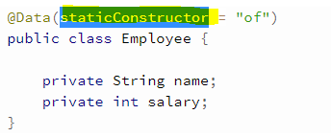
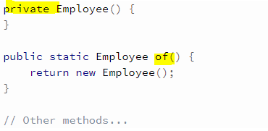
@NoArgsConstructor, @RequiredArgsConstructor (for the final and @NonNull fields), @AllArgsConstructor - DataEvent,UnknownEventSubscriber(X)
- for all e.g. @AllArgsConstructor(staticName = "of"), - allows creation of static factory method
@Data - get all this for free: A shortcut for @ToString, @EqualsAndHashCode, @Getter on all fields, @Setter on all non-final fields, and @RequiredArgsConstructor!
e.g. UnknownEvent, CobolDocumentModel
- staticConstructor = "of" - Lombok generates a private constructor and a public static factory method:
DTO - @Value (thread safe), immutable entity (final class with imm. members, @Value is immutable variant of @Data ): No setter by Default, constructor arguments (except final fields that are initialized in the field declaration) is also generated. @Value is shorthand for: final @ToString @EqualsAndHashCode @AllArgsConstructor @FieldDefaults(makeFinal = true, level = AccessLevel.PRIVATE) @Getter . Also, any explicit constructor, no matter the arguments list, implies lombok will not generate a constructor
e.g. Locality, ElementItem
- @Value(staticConstructor = "of"), to make some fields @NonFinal

Slide 5
@Builder - build immutable data objects with their simple, fluent syntax. If needed a builder for specific fields, we should create a constructor/method with only those fields.
@Singular - the builder doesn't generate a setter method. Instead, it generates two adder methods.
e.g. SyntaxError, AnalysisFinishedEvent
.rules(Arrays.asList(“rule1",“rule2")) → .rule(“rule1“).rule(“rule2").
Builder with Default Value
1. via toBuilder()
2. @Builder.Default - e.g AnalysisFinishedEvent
lombok.singular.useGuava to true, Lombok uses Guava's immutable builders and types.
CheckedExceptions and Ensure Your Resources Are Released
@SneakyThrows, @Cleanup
e.g. Messages

Slide 6
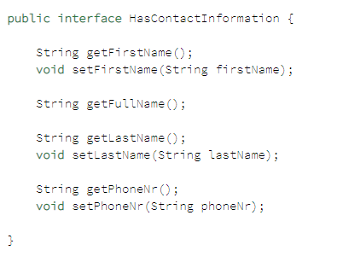
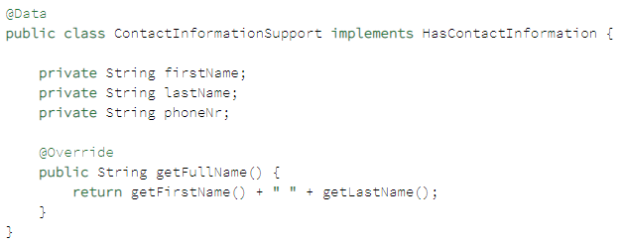
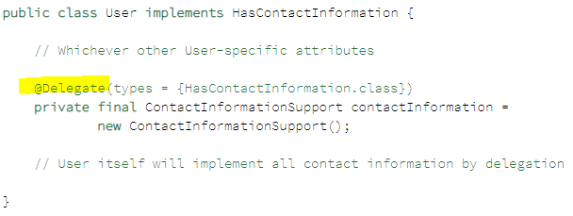
Experimental: Automate Objects Composition - “favor composition inheritance”, (Traits or Mixins )

Slide 7
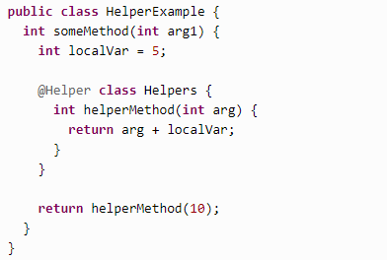

Experimental Lombok - https://projectlombok.org/features/experimental/all
@UtilityClass
@Accessors
@Helper - you can declare classes inside methods
@Delegate
Val: val example = new ArrayList<String>();,
CobolLineIndicatorProcessorImplTest
Var(promoted): var (mutable) like val, but not marked as final
@Tolerate - lombok pretend it doesn't exist, i.e., to generate a method which would otherwise be skipped due to possible conflicts. Similar concept: Hijack in ClearCase (or ignore)
@Jacksonized - v1.18.14: add-on annotation for @Builder, @SuperBuilder,
auto- configures builder to be used by Jackson's deserialization
Promoted: @Value, @Builder, @Wither: renamed to @With, and promoted
Immutable 'setters' - methods that create a clone but with one changed field.

Slide 8
Delombok: java -jar lombok.jar delombok src -d src-delomboked
Or and Ant-task:
Delombok tries to preserve your code as much as it can, but comments may move around a little bit, especially comments that are in the middle of a syntax node.
@Builder - build immutable data objects with their simple, fluent syntax
@SuperBuilder - https://www.baeldung.com/lombok-builder-inheritance
@Setter → @With: The next best alternative to a setter for an immutable property is to construct a clone of the object, but with a new value for this one field.
if the superclass doesn't have a no-args constructor, Lombok can't generate any constructor in the subclass

Slide 9

THANK YOU

